Slide 1
For JDU DP)ServiceNow training Overview
JGG)CA) Service Control Group
Application Development Standardization Promotion Team
2023/3

Slide 2
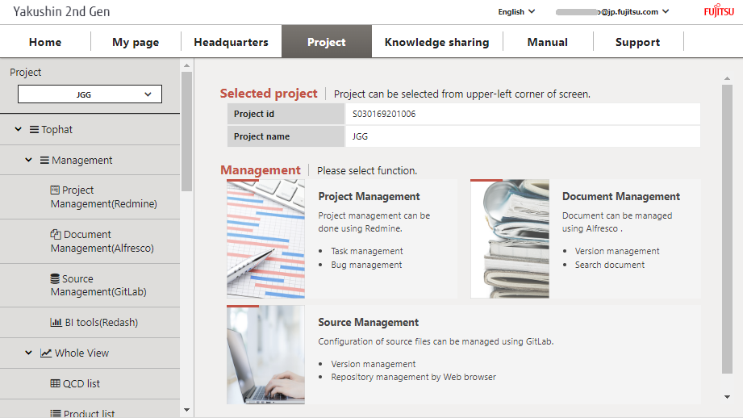
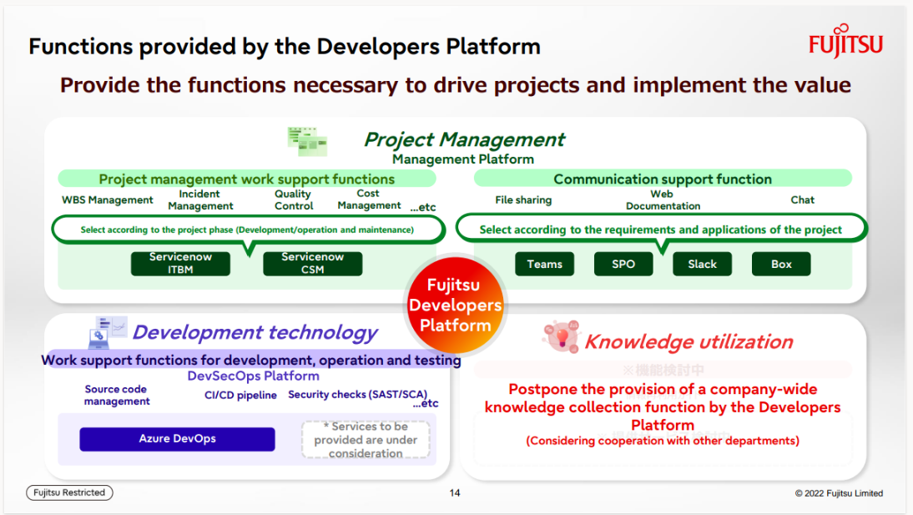
Introduction
Yakushin to Fujitsu Developers Platform
Yakushin
Fujitsu Developers Platform

Slide 3
Tools
Yakushin
Fujitsu Developers Platform (DP)
TypeA Project
Redmine
ServiceNow (ITBM)
Today’s Training
Alfresco
SharePoint Online
GitLab
Azure DevOps
Global communication NEXT
Teams
Global communication NEXT
Teams

Slide 4
flow of business
ASPM
JDU PM
Developer
Prior confirmation and preparation
DP Application
ServiceNow
basic information registration
(Common Items)
ServiceNow
basic information registration
(Each Process)
Work /
ServiceNow
actual information registration, updating
Project Management

Slide 5
Today's schedule
Refer to Draft Schedule.

Slide 6
Key points in the Developer section
When the “Actual effort” for a project task is grayed out and cannot be entered. =>Set "Update Actual Effort from Timecard" to "No" on the “Preferences" tab of the project screen.
Actual time for tasks => Update “Actual Effort” of task ⇒ Reflected in dashboard Man-hour management => Each member registers for their own timesheet ⇒ Daily reports (Each line in a timesheet is called a timecard.) Fujitsu‘s current ServiceNow does not allow PM to manage timesheets. Can only see/update your own time sheet.
Issues (= Issues and QA) is under the program Not under project. In order to manage “issues ” (= issues and QA) across the business.

Slide 7
Thank you.

